Slide 1
Capstone Project Airbnb analysis Prajwal M V

Slide 2


Slide 3

Air Bed and Breakfast
An online marketplace that involves the renting of property to travelers.
Airbnb does not own any of the properties. It provides a platform on which people can rent out their properties or spare rooms to guests.
Prices are set by the property owners and money is collected via the Airbnb app.
There are many different types of Airbnbs. You can rent a room in someone’s house or a whole island and everything in between.
Airbnb operates from >65000 cities and 191 countries.

Slide 4
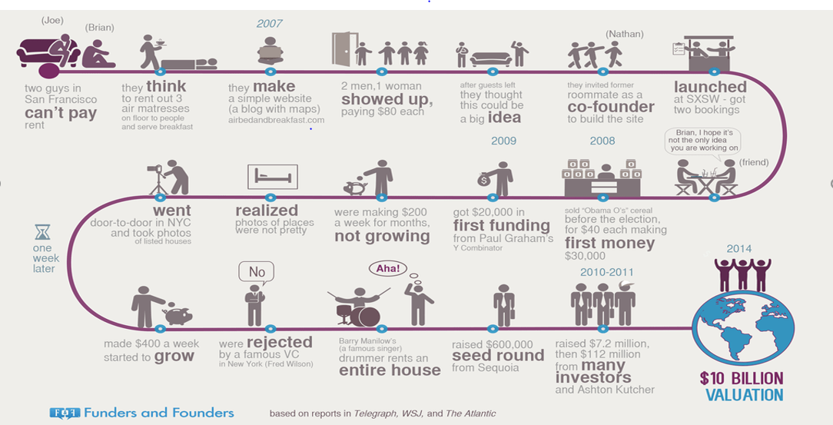
How did it start?

Slide 5
City of interest: New York City
Dataset provided for Analysis is of New York City
The City is divided into 5 Boroughs namely Manhattan, Bronx, Queens, Brooklyn, and Staten Island.
These Boroughs are further divided into distinctive neighborhoods.
Today New York is USA’s largest Short-term Rental market, with >30K hosts.

Slide 6
Discussion Topics :
How many bookings were made in each borough.
Number of Hosts in each Borough of NYC.
Types of rooms each borough has to offer.
Neighborhood with most bookings, which Hosts has most bookings.
Based on room type, an average number of nights the customer must stay.
Availability of room in each borough. Top reviewed Borough, Room type.
Price variation in each borough, based on the room types.
Number of reviews received by the Airbnbs on the basis of neighbourhood groups ,Price and room types.
Words Host use most to attract the customers for bookings.

Slide 7
Data Analysis Steps:
Import Libraries:
In this part, we had imported the required libraries to perform Exploratory Data Analysis for the Airbnb dataset.
Descriptive Statistics:
In this part, we start by looking at descriptive statistic parameters for the dataset. We will use describe() for this
Missing Value Imputation:
We will now check for missing values in our dataset. In case there are any missing entries, we will impute them with appropriate values
Graphical Representation:
We will do Univariate and Multivariate Analysis .So we use Matplotlib and Seaborn libraries of Python for various graphical representations.

Slide 8
Attributes of each variable:
id: Unique for each listing available in the dataset. Total 48895 unique id’s are available in data.
name: Name of the listings available in the dataset. Total 47905 named hotels available in NYC.
host_id: Unique for each host who has listed rooms for rent on Airbnb. Total 37457 hosts with their id’s.
host_name: Name of Host. Total unique 11452 host_names in data set.
neighbourhood_group: Names of each borough in NYC city. In data all available hotel locations Manhattan, Brooklyn, Queens,Bronx, State Island.
neighborhood: Locale area in each borough of NYC. Total 221 neighborhoods.
latitude, longitude: Co-ordinated for each listing in the dataset. These are in between 40.72 and -73.95.
room_type: Each type of room available for listing. In all areas Private rooms, Entire home/apt, Shared room types are available.
price: Price of each listing in the dataset. Price between 0 to 10000.
minimum_night: Mandatory number of nights room needs to be booked
number_of_review: Number of reviews for each listed property. In 0 reviews and max 629 reviews.
last_review: Last date the listing was reviewed.
review_per_month: Number of reviews received per month.
Calculated_host_listing_counts: Number of Listings each host owns.
Availablity_365: Number of days in the year the listing is available for booking. Availability zero to 365 days.

Slide 9
Sorting variable types:
Categorical Variables:
name, host_name, neighbourhood_group, neighbour, room_type.
Numeric Variables :
id, latitude, longitude, price, minimum_nights, number_of_reviews, last_review,review_per_month, calculated_host_listing_counts, availability_365.
Insights on variables:
Each host_id could have multiple listings in the neighborhood, but each listing can have one and only one host_id.

Slide 10
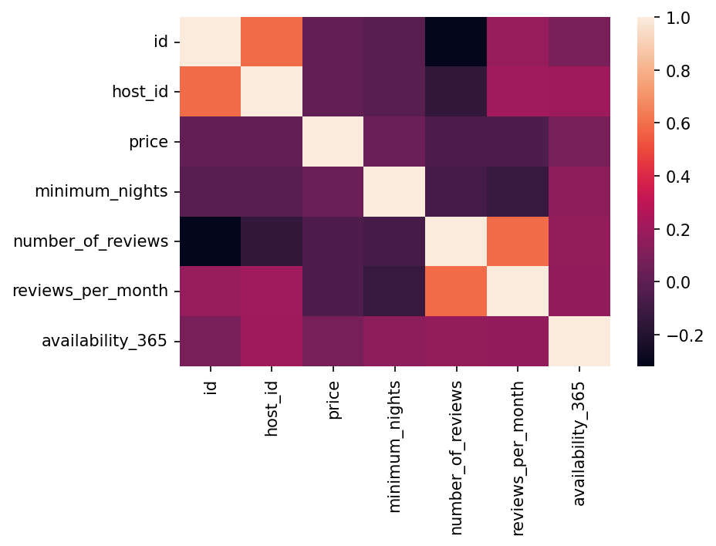
Correlation between Variables
Attached heat map helps us understand the correlation between the variables of our dataset.
(host_id ,review_per_month),(host_id, availability_365) are sets of positively correlated variables.
Correlation for other sets is mostly close to zero.

Slide 11
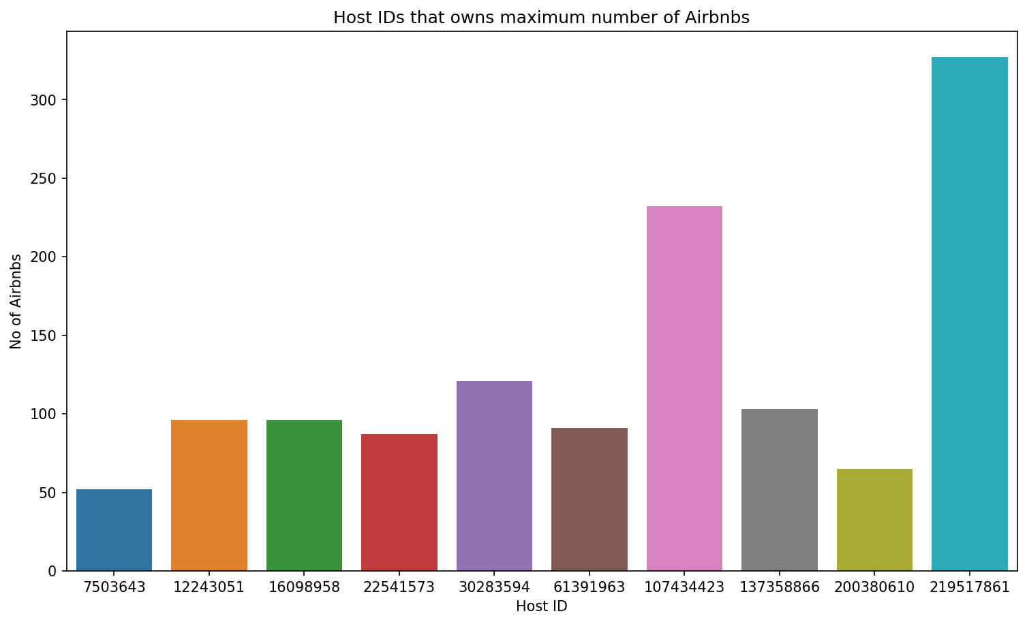
Top 10 host IDs that owns the maximum number of Airbnbs in the New York City
Host Sonder(NYC) with host_id 219517861
has hosted most customers .
Host, Blueground with host_id 107434423
is the second-highest customers hosted.
Host, Kara with host_id 30283594 has
is the third highest customers.

Slide 12
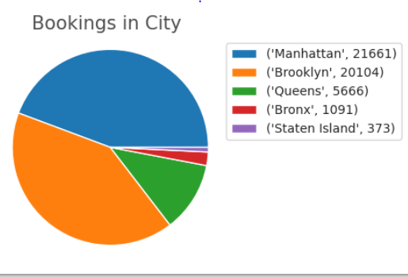
Bookings made in each borough.
Manhattan has the most bookings with 21661.
Brooklyn is the second-highest with 20104 bookings.
The Bronx and Staten Island trail the pack with 1091 and 373 bookings.

Slide 13
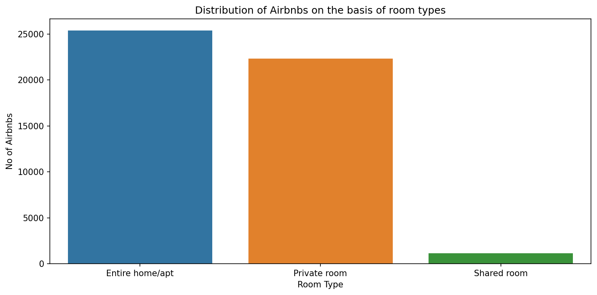
Distribution of Airbnbs on the basis of room types
Shared room are lot less in comparison to other room types.
It can be seen that count of entire home and private room is too high, so people would be booking them a lot

Slide 14
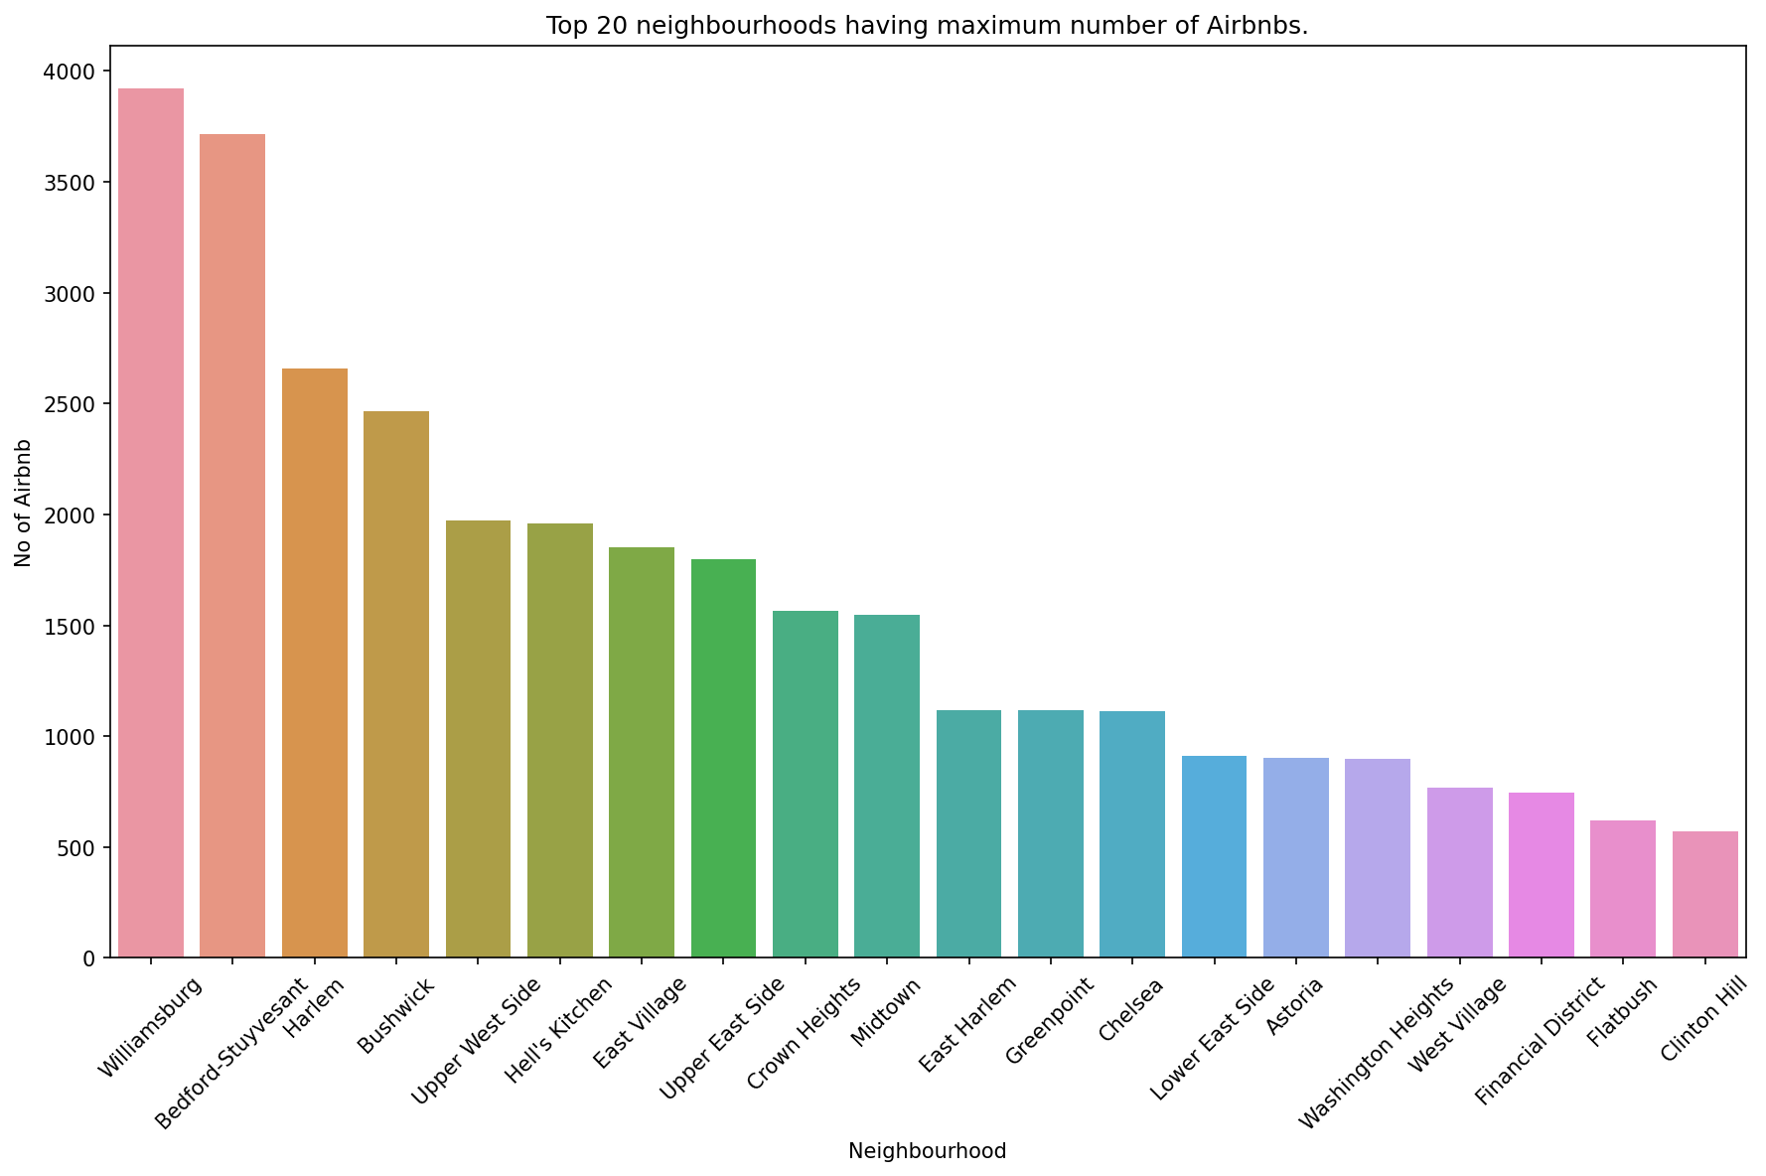
Top 20 neighbourhoods having maximum number of Airbnb

Slide 15
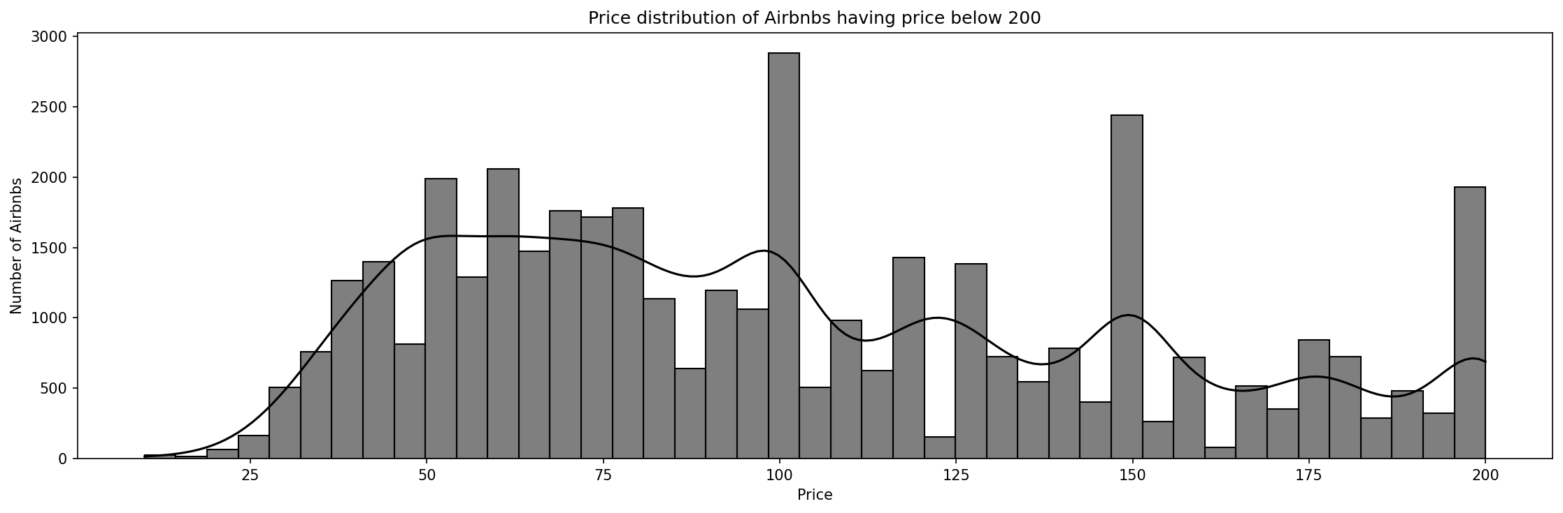
Price distribution of the Airbnbs across the New York City below $200
• Only a few Airbnbs had a price above $200, so to obtain a good distribution and to include maximum data we excluded the Airbnbs above the price range of $200.
• Below a price $100 we can see a larger distribution of Airbnbs.

Slide 16
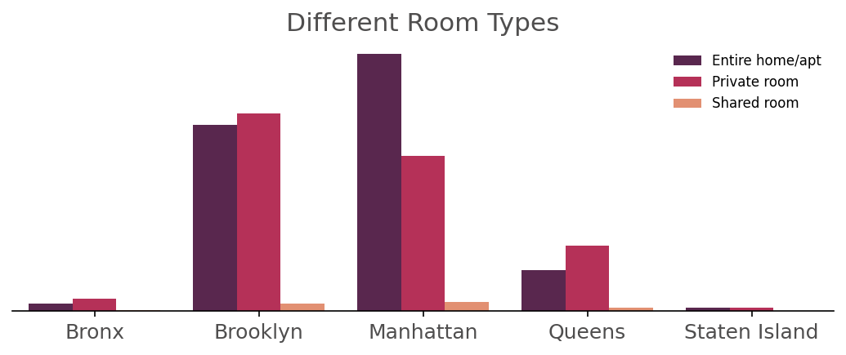
Types of rooms each borough has to offer
Manhattan leads the group with the most rooms bookings, Customer prefer Entire homes more compared to Private rooms in Manhattan.
Customer in Brooklyn prefer Private rooms more than Entire rooms.
Except in Manhattan all the other boroughs have more bookings for a private room.
Shared rooms are the least preferred type across all the boroughs of NYC.

Slide 17
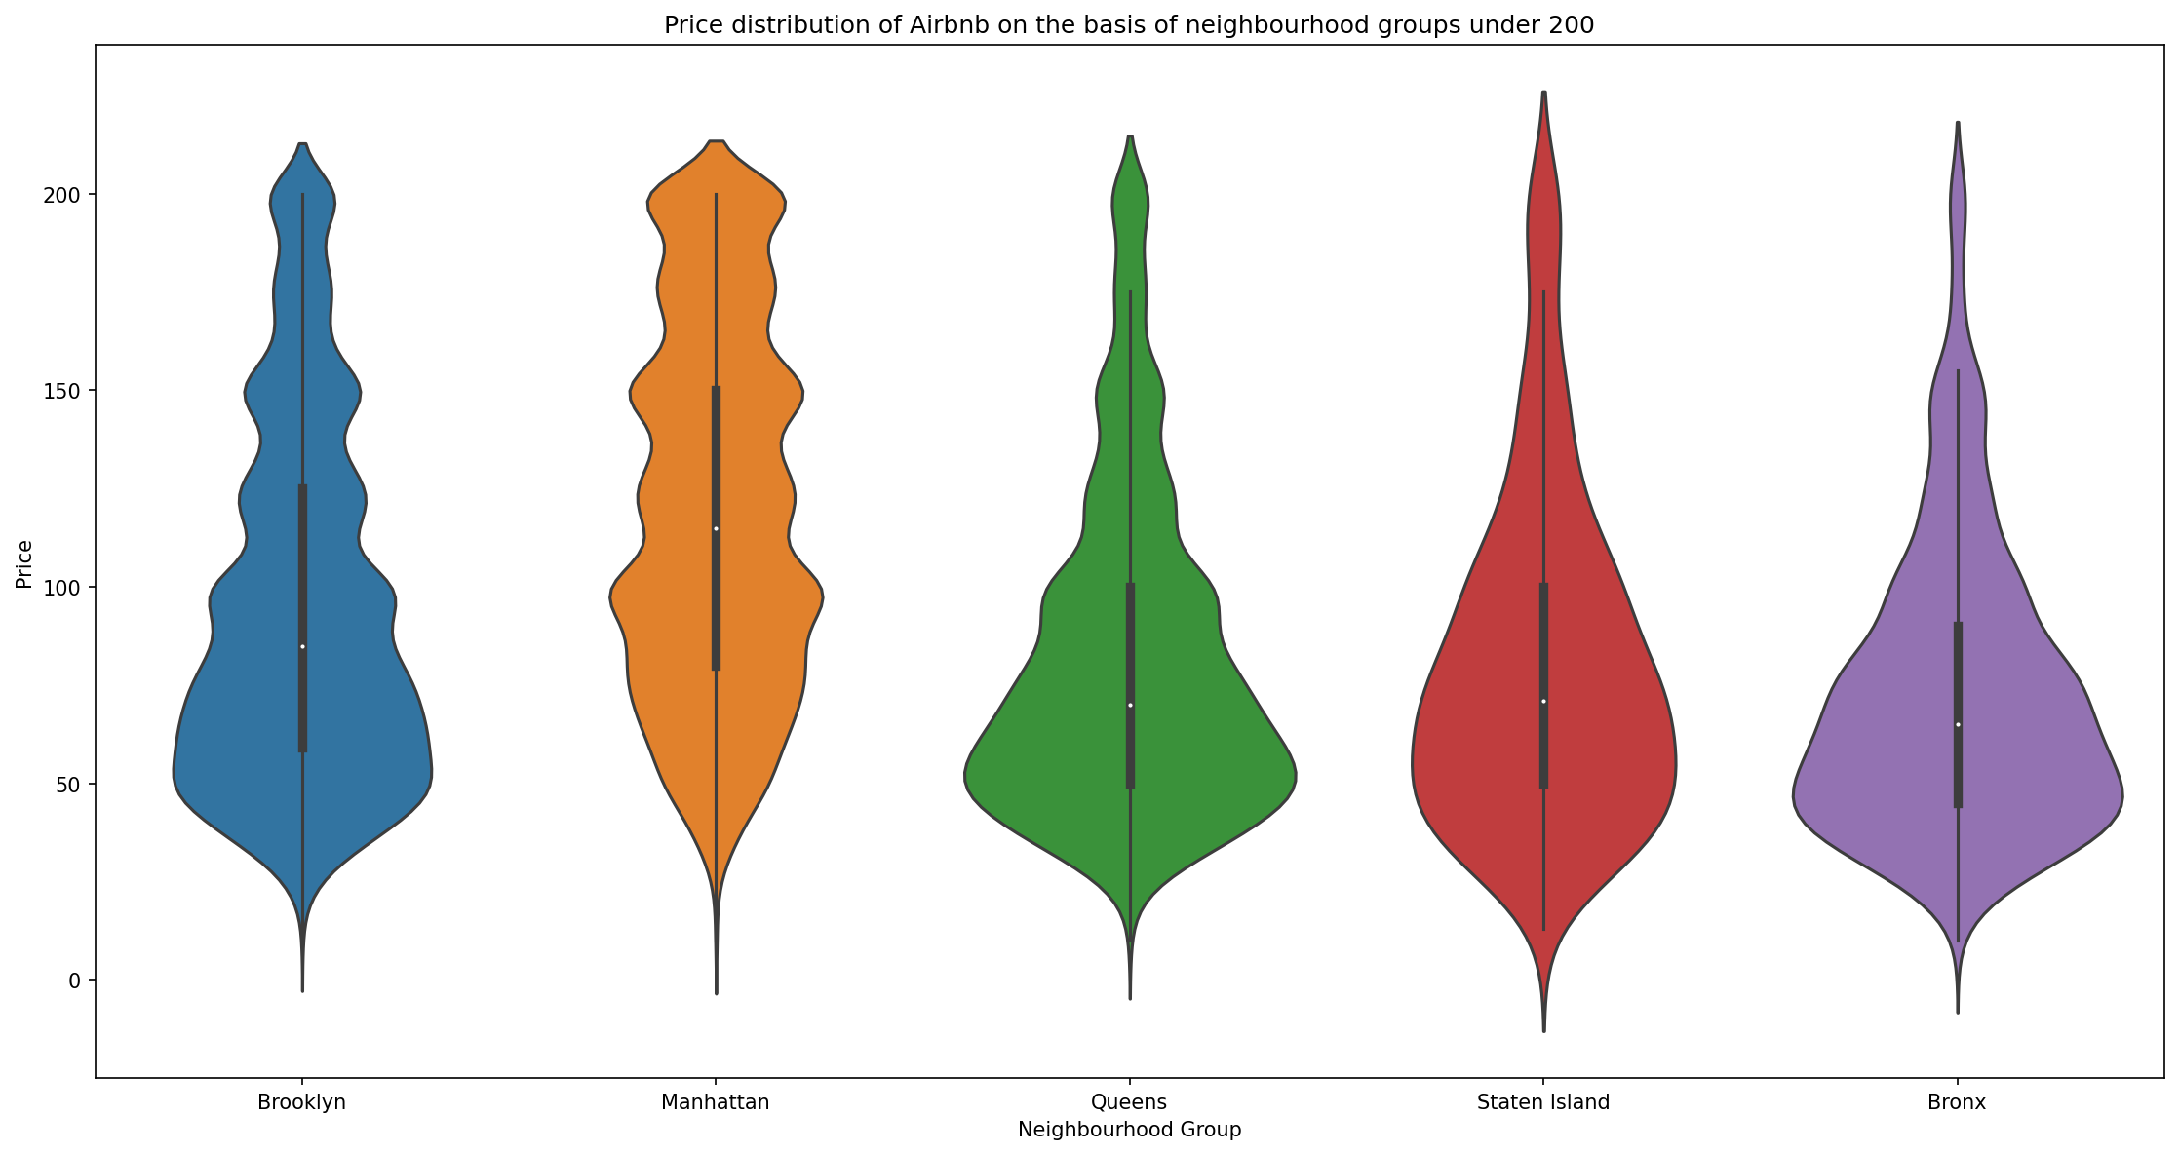
Price distribution of Airbnbs on the basis of neighbourhood groups
• Queens, Staten Island and Bronx have the price distribution below its mean price around 50.
• In comparison to other neighborhood groups, Brooklyn and Manhattan has a greater distribution above the price of 100 that concludes these areas have costlier hotels in the the New York City

Slide 18
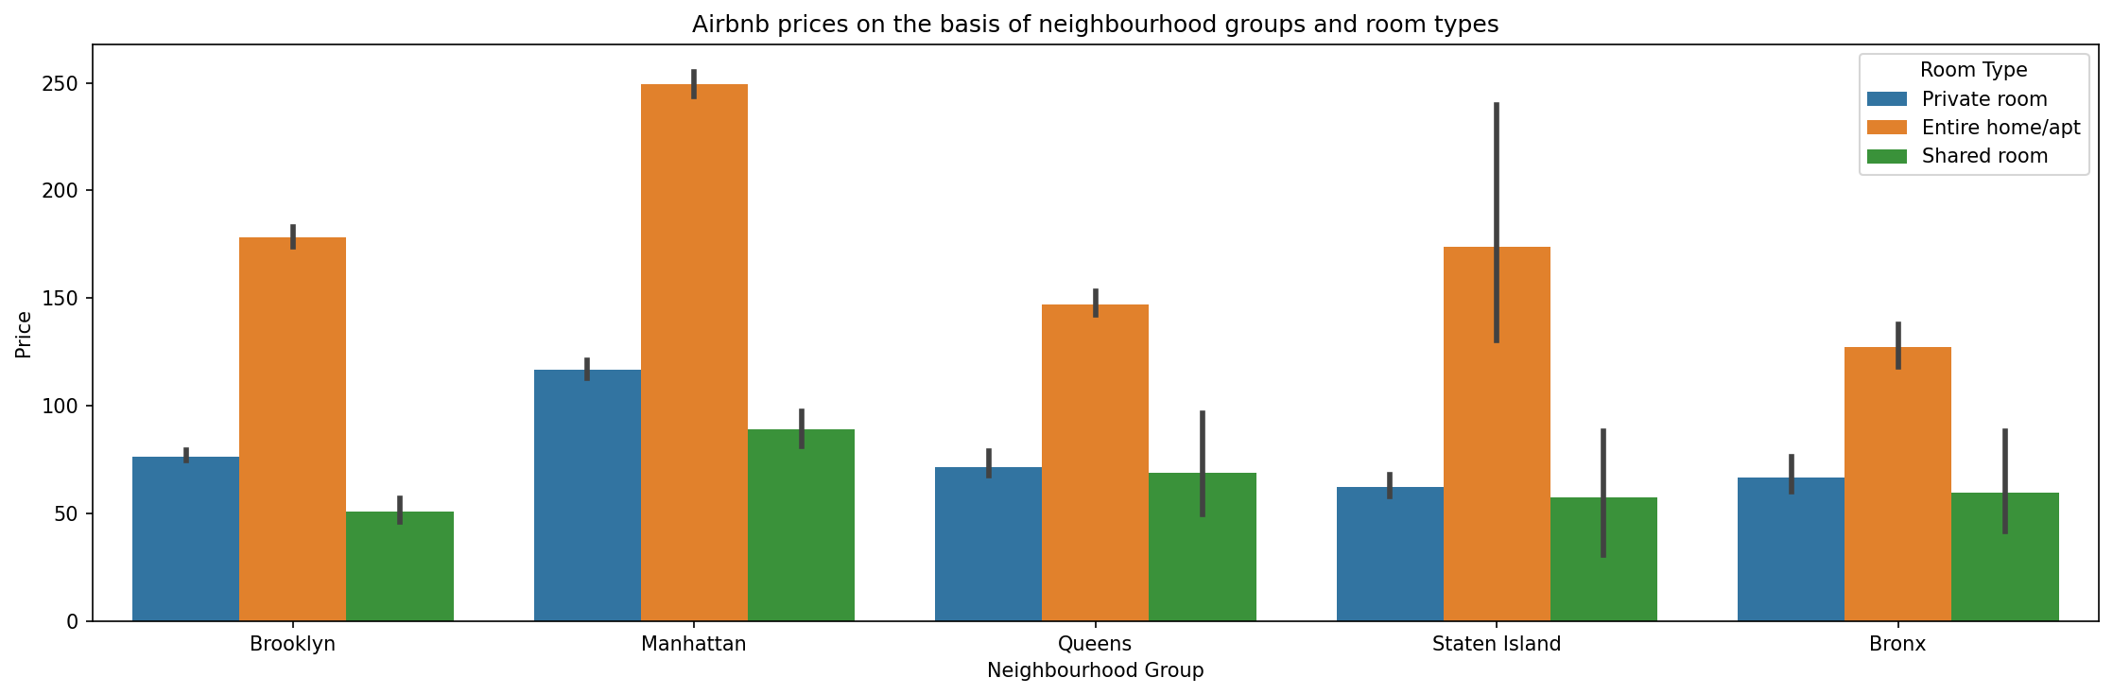
Airbnb prices on the basis of neighbourhood group and room type
• The price of entire home is very high in all the neighbourhood groups
• The price of the shared rooms are lesser throughout the neighbourhood group

Slide 19
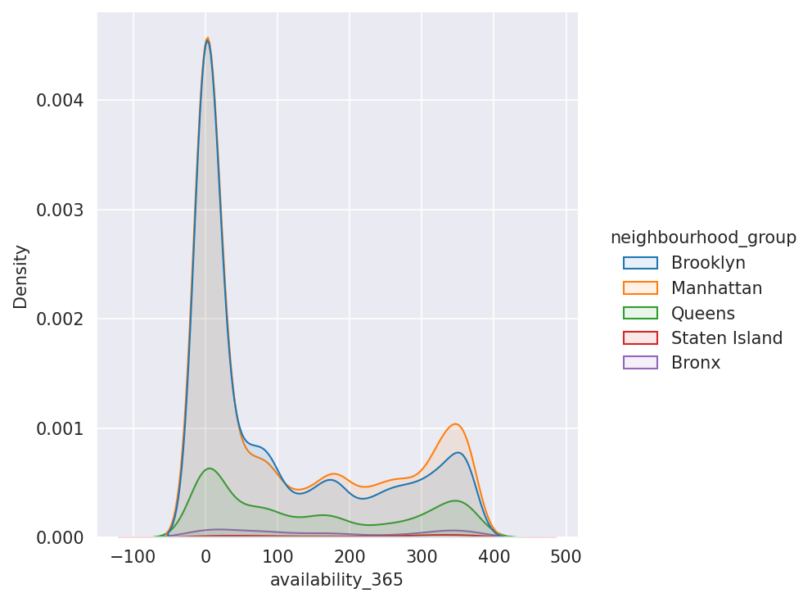
Availability distribution across New York City
Manhattan and Brooklyn have very similar distribution with peaks close to zero.
This shows most of the rooms are mostly booked in Manhattan and Brooklyn.
Availability of rooms is more evenly distributed compared to Brooklyn and Manhattan.

Slide 20
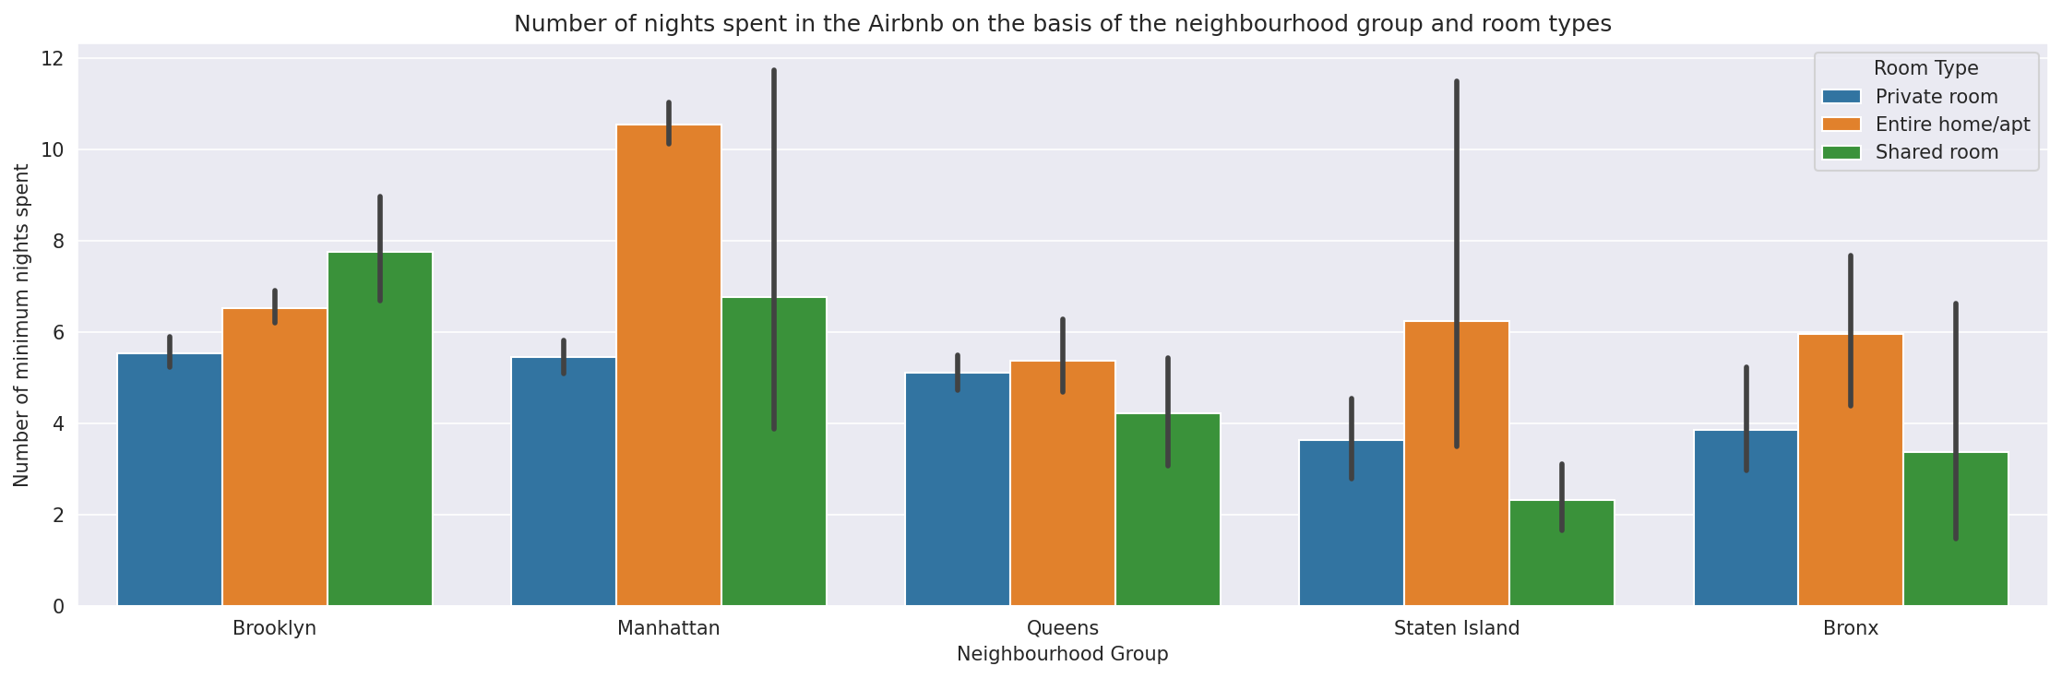
Relation Between Number Of Minimum Nights Spent At Each Neighbourhood Group

Slide 21
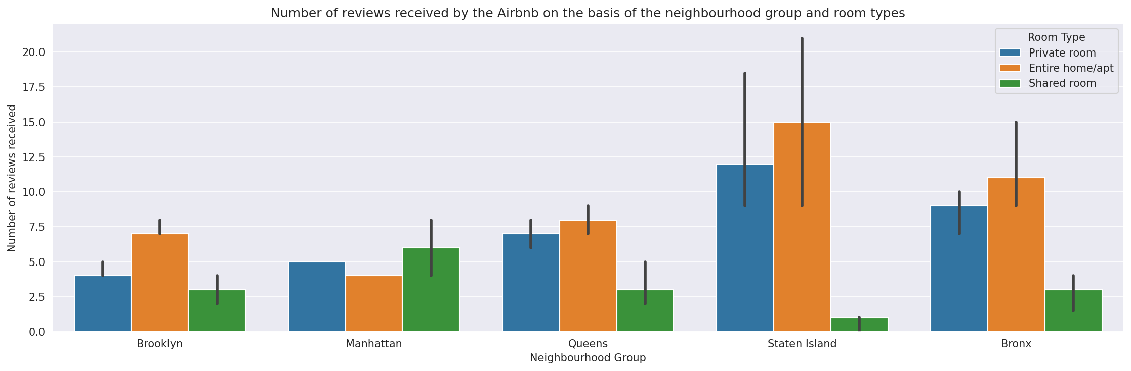
Number of reviews received by the Airbnbs on the basis of neighbourhood groups and room types

Slide 22
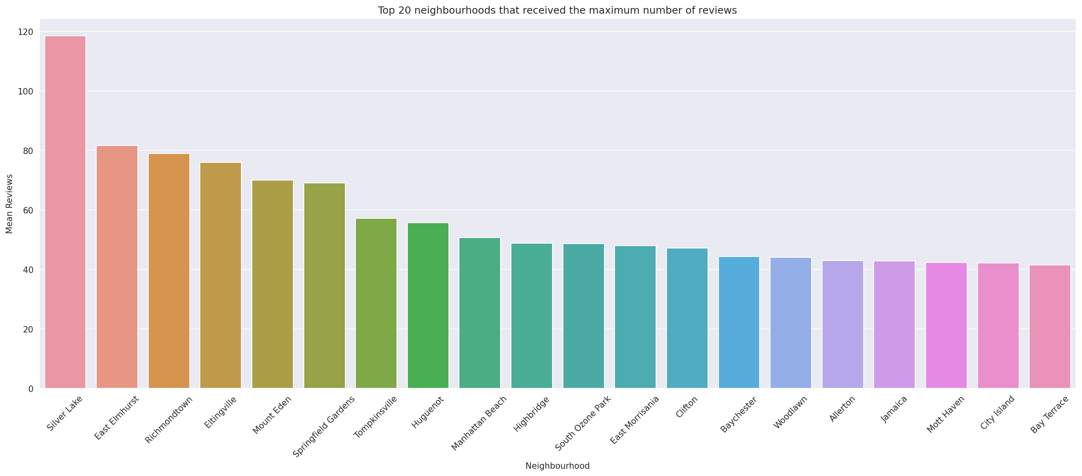
Top 20 neighbourhoods who received the maximum number of reviews

Slide 23
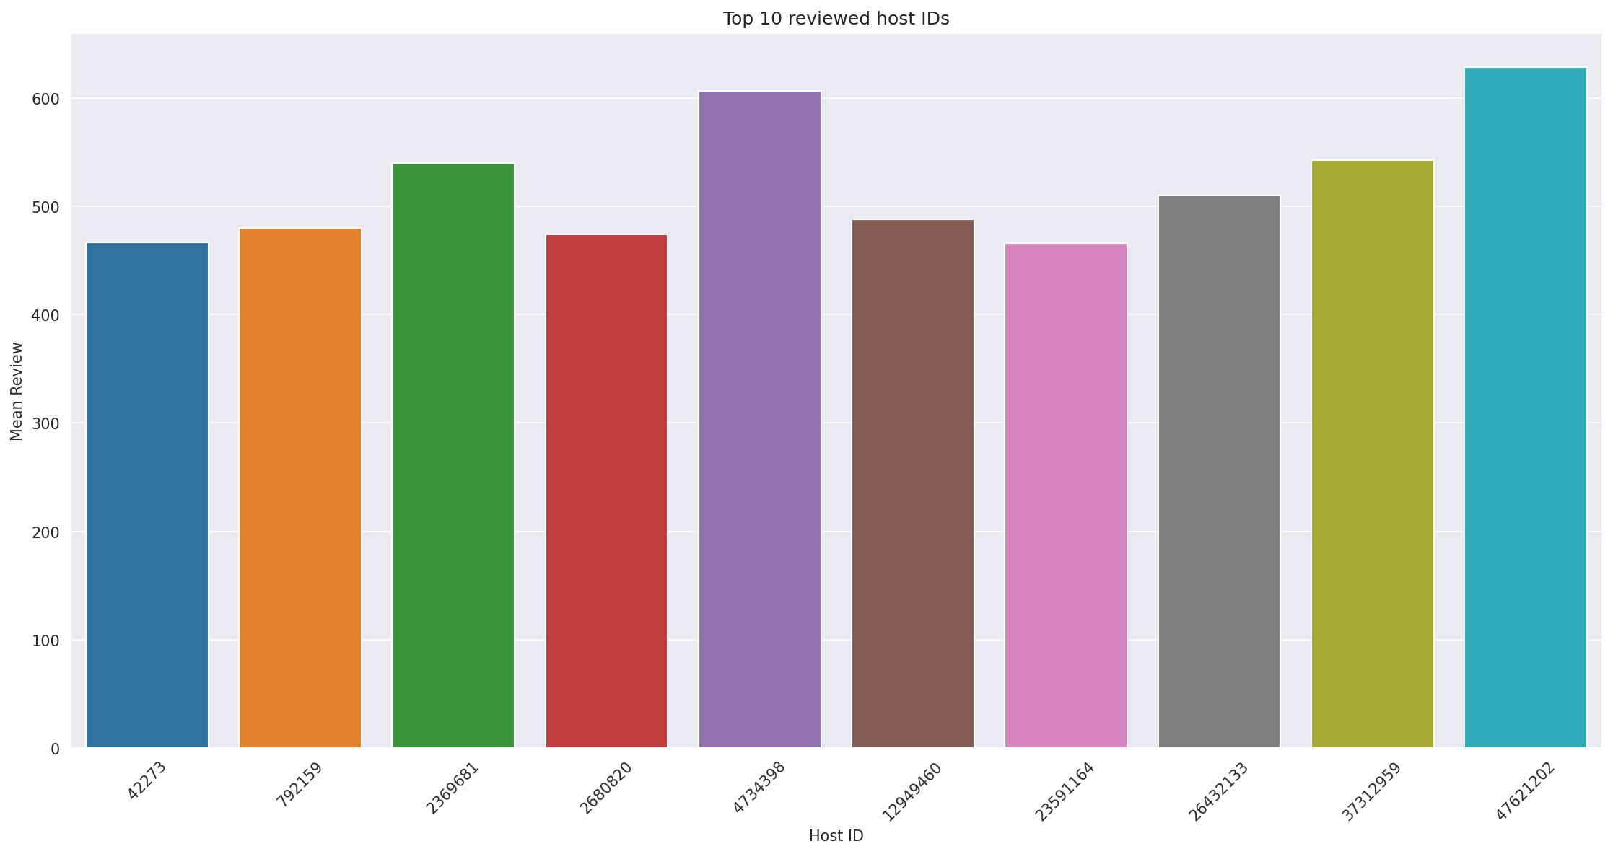
Top 10 reviewed host IDs

Slide 24
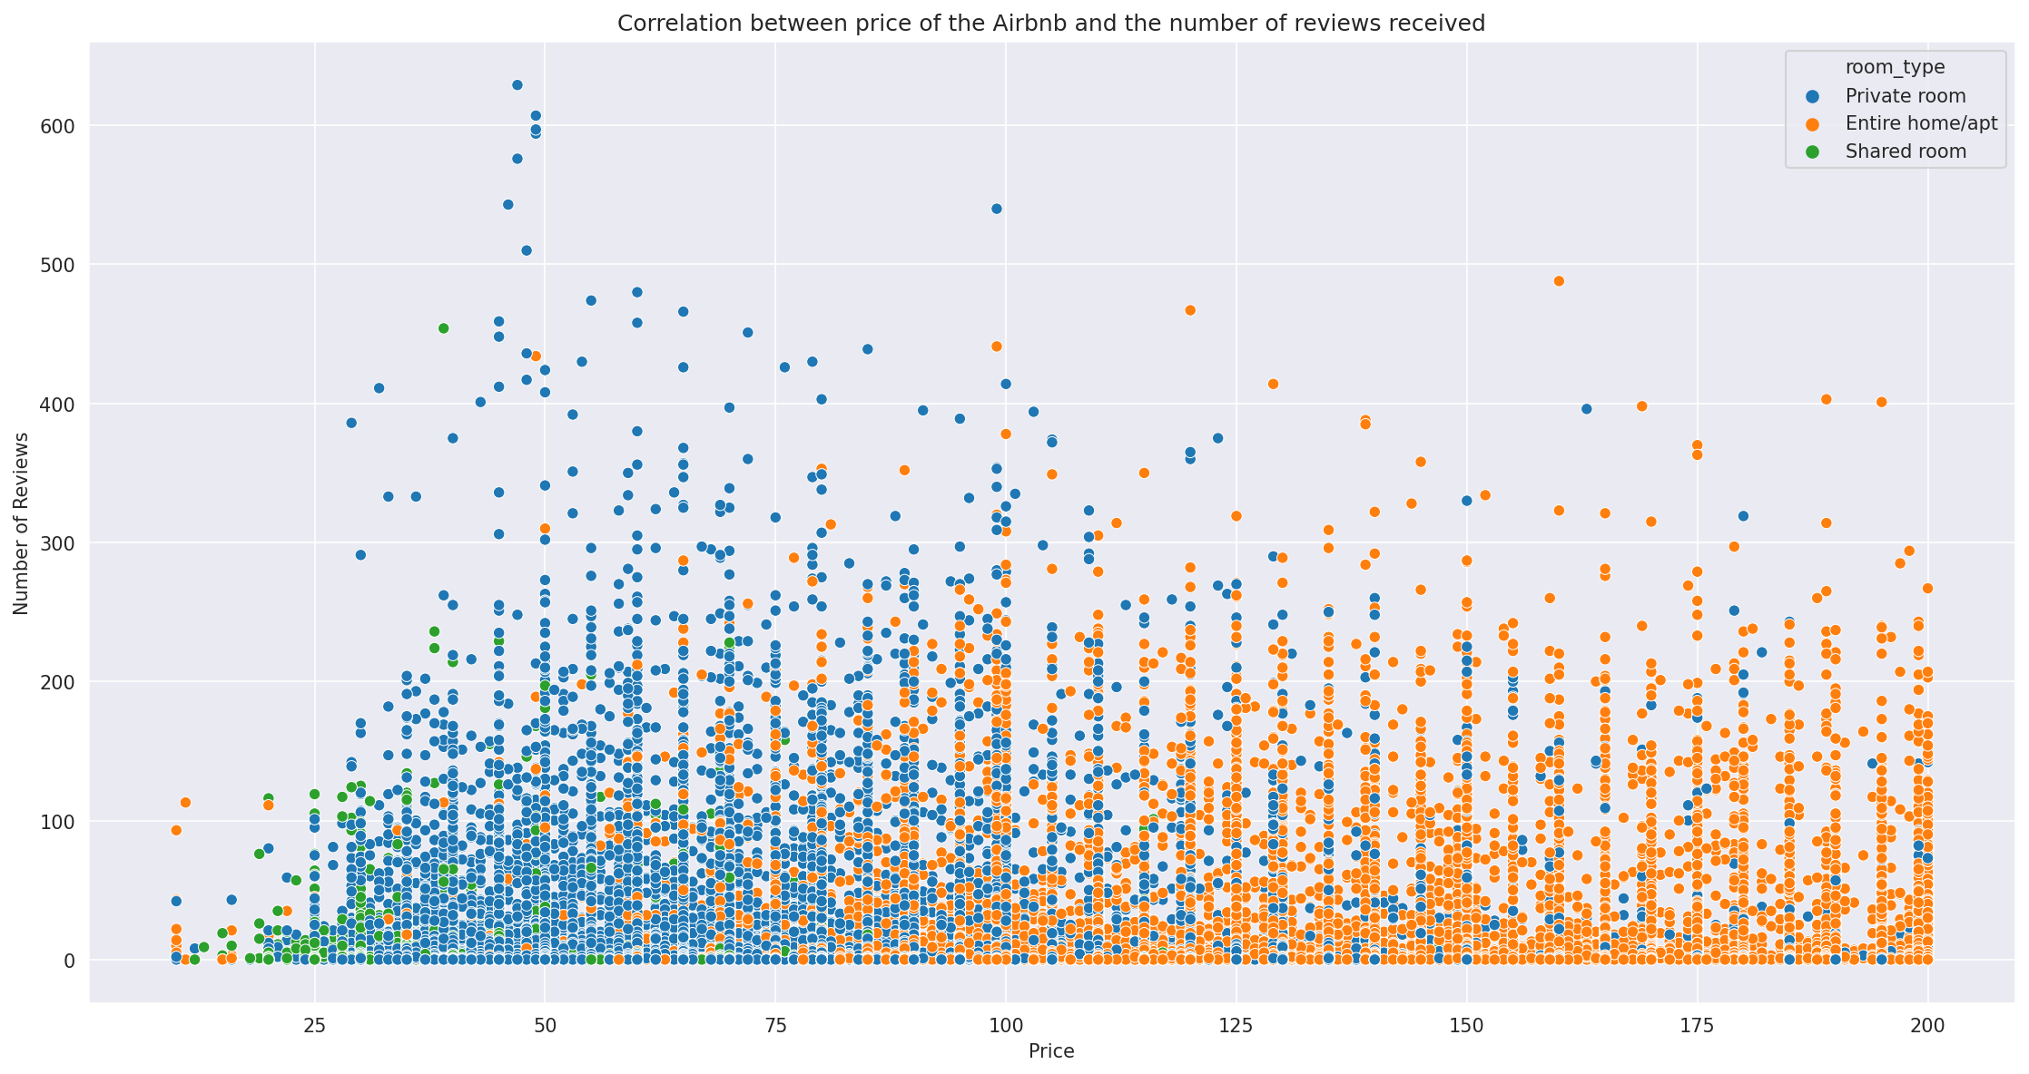
Pricing, Room reviews for room types
Attached joint plot shows us the price variation for room types and the number of reviews.
Private rooms have positively skewed distribution with prices mostly in the range of 0-100 USD.
Entire home has more evenly distributed pricing compared to Private, shared rooms
Room review is also positively skewed with most reviews condensed at zero.
Shared rooms are the least reviewed amongst the room types.
CO OF AIRBNB

Slide 25
Observations from Airbnb analysis
Most booking, Most number of hosts: Manhattan followed by Brooklyn, Queens, Bronx, and Staten Island.
Most booked Room Type: Private Room, followed by Entire type, the Shared room is the lowest book.
Manhattan has more bookings of Entire room compared to Private room. Other boroughs have more bookings of Private rooms compared to the Entire room.
Most booked neighborhood is Williamsburg, followed by Bedford-Stuyvesant, Harlem, Bushwick, and Upper West Side. All these neighborhoods belong to Manhattan and Brooklyn.
Average Mandatory number of nights for booking of Entire home is 9, the Shared room is 6 and lowest for Private room 5 nights.
Brooklyn has the least availability of rooms available for booking followed by Manhattan.
Private rooms are mostly reviewed, Entire homes get the second attention, Shared rooms are least reviewed. Manhattan and Queens are the most reviewed Boroughs.
Entire Homes are most expensive, followed by Private, Shared rooms, Manhattan is the most expensive borough for all types of rooms.

Slide 26
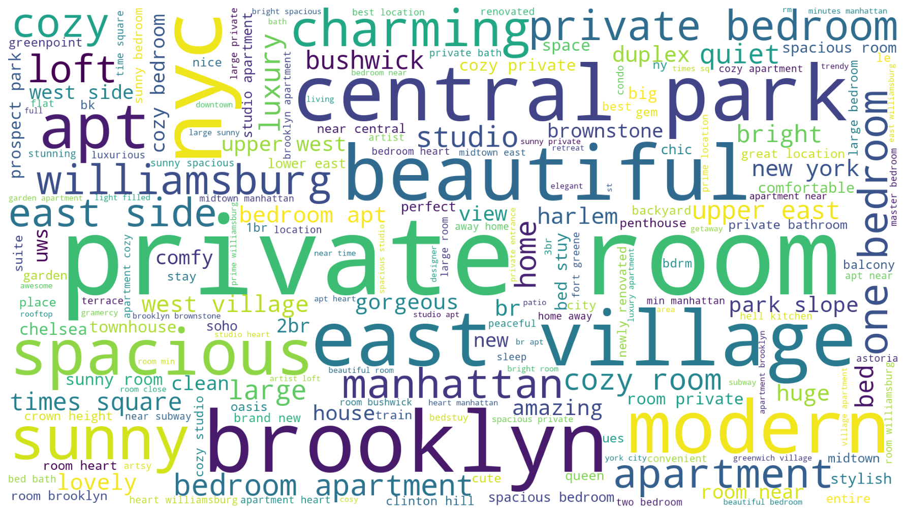
Listing names in each Neighborhood

Slide 27
Conclusion
Customer Needs Rental space with Cheaper rent, good reviews, lower minimum nights, proximity to transportation services and good space.
Based on the Word plot, the list of Words that are used to seek Customer attention are:
Mordern, Beautiful, Private room, Brooklyn, NYC, Central Park, spacious, subway, Williamsburg, Bushwick, times square.

